Slide 1
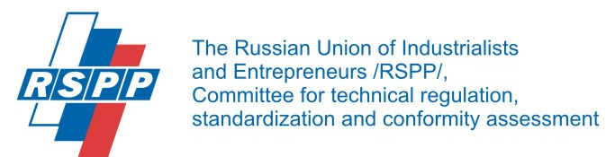

WG 1.2 Accreditation
Accreditation is a third-party attestation related to a conformity assessment body conveying formal demonstration of its competence to carry out specific conformity assessment tasks.
s
Scope & Objective
to exploit the potentials of accreditation as tool for trade
to reduce technical barriers across economic sectors by fostering the recognition of CAB results between EU/DE and EEU/RF
Mutual recognition of CA results is based on ILAC/IAF MRAs, but in the regulated areas acceptance of CA results is decided by national regulators
Suggestion: Identification of concrete areas/ product sectors in which to use accreditation to foster the acceptance of CA results
“Service provider” for the other WGs
Quality infrastructure
Accreditation
Conformity assessment
certification
inspection
testing
calibration
Requirements for products and services
legislation
International/ national standards (ISO, DIN…)
Technical specifications/ private standards

