Slide 1
REGULATIONS AND STANDARDS IN THE CONSTRUCTION SPHERE OF THE RUSSIAN FEDERATION
MINISTRY OF CONSTRUCTION, HOUSING AND UTILITIES OF THE RUSSIAN FEDERATION
Federal Centre for Regulation, Standardization
and Technical Assessment in Construction (FAU FCC)
Alexander Neklyudov
Deputy Director of the FAU FCC
30.03.2021

Slide 2
RUSSIAN EXPERIENCE OF TECHNICAL REGULATIONS IN THE CONSTRUCTION SPHERE
TECHNICAL REGULATIONS FOR BUILDINGS AND CIVIL ENGINEERING PROJECTS
Federal Law of 30.12.2009 No.384-ФЗ "Technical regulations on safety of buildings and structures”
OTHER TECHNICAL REGULATIONS
Federal Law of 22.07.2008 No.123-ФЗ "Technical regulations on the fire safety requirements";
Technical regulations "On safety of gas distribution and gas consumption networks";
CU TR-002-2011 "On safety of the rapid (highspeed) transit railway transport";
CU TR-003-2011 "On safety of the railway infrastructure";
CU TR-014-2011 "Roads safety";
EEU TR 49/2020 Technical regulations of the Eurasian Economic Union "On requirements for the main pipelines for transporting liquid and gaseous hydrocarbons"
BEYOND THE TECHNICAL REGULATIONS LEGISLATION
Federal Law of 30.03.1999 No.52-ФЗ "On sanitary-epidemiological well being of people";
Federal Law of 10.01.2002 No.7-ФЗ "About environment protection";
Federal Law of 26.03.2003 No.35-ФЗ "About electric energy";
Federal Law of 21.07.1997 No.116-ФЗ "About industrial safety of hazardous industrial facilities";
Federal Law of 21.07.1997 No.117-ФЗ "About safety of waterworks";
Federal Law of 21.11.1995 No.170-ФЗ ”About utilisation of the nuclear energy";
Federal Law of 23.11.2009 No.261-ФЗ "About energy efficiency and energy performance improvement”;
Etc.

Slide 3
General Requirements to Safety of Buildings and Structures
Mechanical Safety Requirements
Safety requirements for users of buildings and structures
Fire Safety Requirements
Safety Requirements for people with disabilities (Accessibility)
Natural and Industrial Disasters Safety Requirements (Resilience)
Energy Efficiency
Health and Safety Requirements to Buildings and Facilities Conditions
Environmental Safety Requirements
"Technical regulations on safety of buildings and structures" (Federal Law No.384-ФЗ)

Slide 4
National Construction Regulation Structure
Technical regulations on safety of buildings and structures
MINISTRY OF CONSTRUCTION, HOUSING AND UTILITIES OF THE RUSSIAN FEDERATION
FEDERAL AGENCY ON TECHNICAL REGULATING AND METROLOGY
List of Mandatory National Standards and Codes of Practice (parts thereof)
Parts of SP (Codes of Practice)
Parts of GOST-R (Standards)
Normalization for Construction: codes of practice and standards research and development. National Technical Committee 465 “Construction” secretariat
Technical assessment of construction materials
Certification of compliance to National Standards
Base Institution of CIS countries-members for construction technical regulation
74
4
List of Optional National Standards and Codes of Practice
SP (Codes of Practice)
GOST-R (Standards)
371
164
Mandatory Required
Recommended

Slide 5
National Technical Committee TC 465 Construction
About 380 companies and organizations are members of TC 465, registered in October 2004 for the purpose of national, regional and international standardization of Construction.
TC 465 is responsible for development of construction standards and codes of practice with their further review and expert approval prior to Rosstandart (GOST R) final approval and implementation across the Russia and/or CIS. Secretariat functions of TC 465 are assigned to FAU FCC, Russia.
Organization, methods and general technical guides for construction
SC 1 Site survey
SC 2 Design. General principles
SC 3 Construction. General principles
SC 4 Facility management and maintenance
SC 5 Building Information Modeling (BIM)
SC 6 Fire safety
SC 8 Building physics. Energy saving, energy efficiency/performance
SC 7 Seismic safety
Urban planning, buildings and facilities
SC 9 Town planning
SC 10 Residential, civil, public and industrial buildings and facilities
SC 11 Design and Construction of Transport infrastructure
SC 12 Design and Construction of hydro technical facilities and reclamation works
SC 13 Design and Construction of Oil and Gas storages and infrastructure
TC 465 Committee Structure
On-site and external utilities, equipment
SC 14 Design and Construction of HVAC and Heat Supply
SC 15 Design and Construction of Water Supply and Sewerage utilities
SC 16 Design and Construction of Gas supply and Gas distribution
SC 17 Low voltage
Structure, elements and foundation
SC 18 Reliability of structures, elements and foundation
SC 19 Geotechnics
SC 20 Steel structure WG 20.1 Steel structures
WG 20.2 Aluminum structures
SC 21 Concrete and reinforced concrete
SC 22 Masonry and stone structures
SC 23 Timber structures
SC 24 Doors, Windows etc.
SC 25 Façades, external walls
SC 26 Refurbishment, repair and enforcement of structure

Slide 6
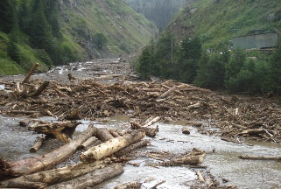
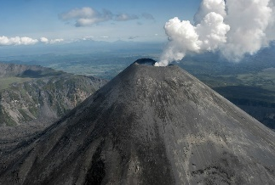
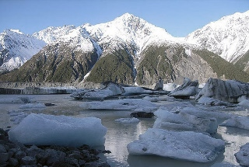
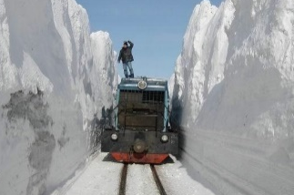
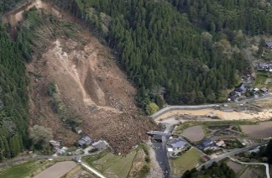
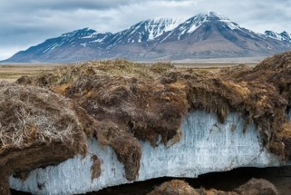
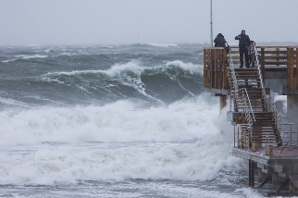
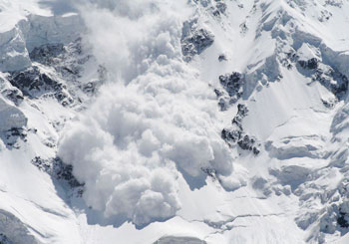
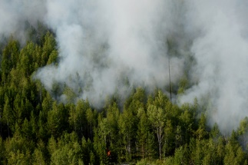
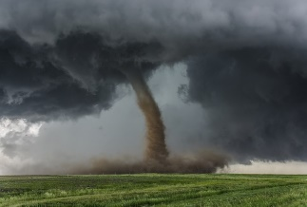
Climate challenges
Up to 2.5% of total Russia territory is flooded every year
Up to 20% of territory is mudslides endangered
17%
3%
Up to 40% of territory is earthquake endangered
69 active volcanoes
Hydrological hazards
Earthquakes & volcanic eruptions
7%
Emergency Situations Percentage by Natural Disasters (2010-2018)
16%
More then 8,000 glaciers
Snowdrift height up to 10 meters
Land-ice breakdowns
Heavy rain & snow, hailstorm
Up to 80% of territory is exposed to sloping processes
1%
19%
Up to 65% of territory is located in ever-frost
Geological hazards
Frost and dry periods
Regular sea storms with wave height up to 6 meters
>1%
>1%
Up to 18% of territory is snow avalanche endangered
Sea hydrological hazards
Snow avalanches
Up to 35,000 wildfires per year
National fire loss up to 100 M USD per year
30%
7%
800 Russian cities is in the tornado endangered zone
Up to 60 m/s is wind speed
Large-scale fire
Snowstorms, wind spouts, tornados

Slide 7
THANK YOU!
 | Alexander Neklyudov, Ph.D.
FAU FCC Deputy Director TC 465 Construction Secretary ISO/TC163 Expert Email: neklyudov@faufcc.ru

