Slide 1
Standards Development
Within the United States
March 2021
Pat Picariello
Director, Developmental Operations
www.astm.org

Slide 2
Discussion Topics
Multiple Path Approach
User/Market-driven
Membership
Neutrality
Funding
Participation
limitations to participation (balance, 1 vote per voting interest)

Slide 3
Types of Existing Standards
Company Standard
Consensus among the employees of an organization.
Consortium Standard
Consensus among a small group of organizations; like-minded companies undertaking an activity to collectively conserve resources.
Industry Standard
Consensus among the many companies within an association or society.
Government Standard
Multiple degrees of consensus. Some written by individuals within agencies, sometimes developed with private sector then adopted by reference as mandatory.
Voluntary Consensus Standard (ASTM sits here)
Consensus is developed by representatives of all sectors that have an interest in the use of the standard (producers, users, and those having a general interest, consumers). Consensus standards, with their broad input, are considered by many as the most technically sound and credible documents. They are often used as the basis for commercial and regulatory action.

Slide 4
Multiple Path & User/Market Driven
Multiple Path – there is not 1 way to accomplish standardization objectives – the ‘industry’ has the power to select its best solution – standards development is a bottom-up process (not top-down like the rest of the world)
User/Market Driven - Industry recognizes power to shape its own destiny (from a standards perspective) and select the organization and/or process that most directly meets its needs

Slide 5
How Are ASTM Standards Used?
Developed voluntarily and used voluntarily
Cited in a contract
Used by tens of thousands of individuals, companies, and agencies globally
Government agency reference them in codes, certification, regulations, and laws, supports P.L. 104-113

Slide 6
Membership & Neutrality
Membership – open to all, balance required, 1 vote/interest
Neutrality – ASTM ensures development process is adhered to; content of standards is developed by members only
Producers
User/General Interest
ASTM
Technical Committees are balanced. No excess influence by any interest group.
Ensures market relevance of the content of standards.

Slide 7
Managing Balance: Voting Rights
1 official vote per interest (company)
All are welcome to participate in technical discussions
All members receive a ballot and are eligible to vote on technical issues
All negatives are considered the same way
*Ensures large and small organizational have fair say in the industry. Keeps market competitive and innovative.
Notes:
Official Voting Rights- ASTM regulations explicitly state that a company/interest can only have one vote. If there are 15 members from an organization on the technical committee, only one of those employees can hold the official vote. This will ensure that larger organizations do not dominate the standards development, giving small and large organizations, including individuals equal representation on the committee. However, most importantly, all members, whether they have an official vote or not, have the right to vote on all ballot items. If a non official voter casts a negative on ballot, that negative must be handled just like any other negative received, official voter or not.
Official voting rights comes in to play when calculating the statistical requirements for a valid ballot (2/3 or 90% affirmative/ 60% return), when determining quorum for conducting official committee business or when raising your hand for a motion at the meeting, such as for a not persuasive negative.

Slide 8
Funding & Participation
Funding – members are volunteers and most SDOs are non-profit organizations – standards are intellectual property and can be sold to generate revenue – membership fees are also common
Participation – committees are microcosms of the industries they represent – anyone can join – no limits on size/# of members
EXAMPLE
Manufacturers
Federal agencies
Design professionals
Professional societies
Trade associations
Financial organizations
Academia

Slide 9
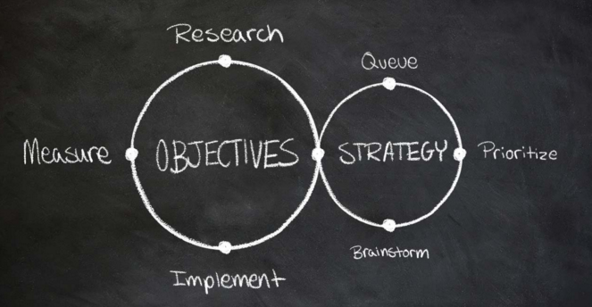
Time Frame for Developing Information
Complexity of the job
Urgency of needs
Time devoted by members
Utilization of new informational technologies
Average Standards Approval: 18 months
New Standards Activities: 7 months
Revisions: 6 months

Slide 10
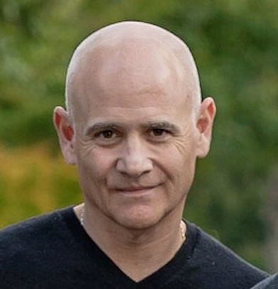
Contact Information
Technical Committee Operations
Pat Picariello
Director, Developmental Operations
T: +1-610-832-9720
E: ppicariello@astm.org
www.astm.org
Global Offices:
Canada
Belgium
Peru
China

